Slide 1
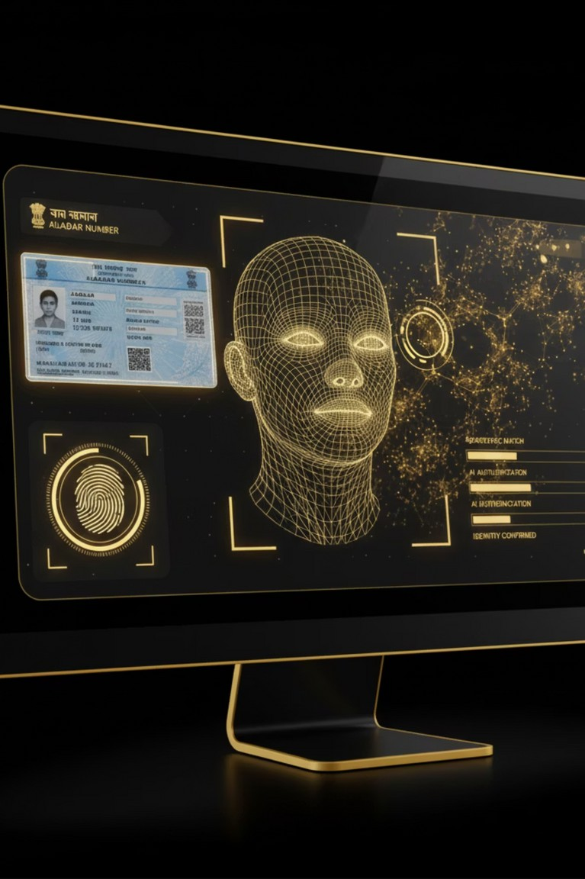

AI-Powered Identity Verification and Fraud Detection for KYC Compliance
Presented By:
Y Teja
Mentor : Kapil Pawar

Slide 2
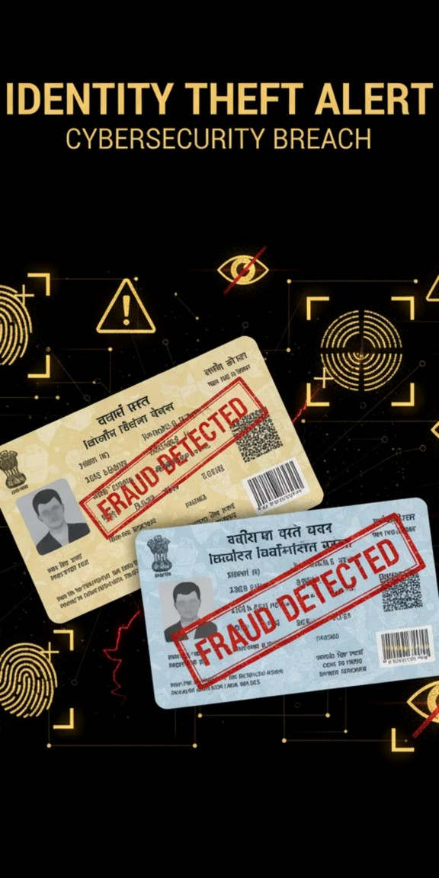
Problem Statement
Why KYC Fraud Detection is Important:
Manual KYC processes are time-consuming and error- prone.
Increasing cases of duplicate Aadhaar, fake PAN, and manipulated identity proofs.
Regulatory frameworks (AML/KYC) require strict compliance and transparency.
Real-World Issues:
Forged documents bypass manual checks.
Lack of automated, scalable solutions for identity verification.
High compliance risks for banks and fintechs.

Slide 3
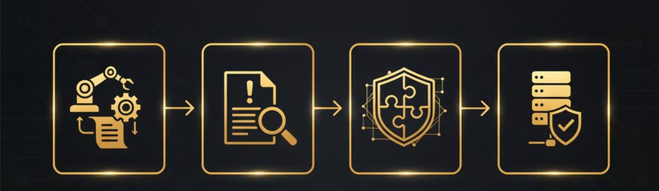
Project Objectives
1
Automate KYC Processes
Automate document-based KYC processes to reduce manual workload.
2
Detect Fraudulent Documents
Detect and flag fraudulent or tampered documents with high confidence.
3
Integrate AML Compliance Ensure smooth integration compliance systems.
4
Deliver Reliable Solution
Deliver a reliable, scalable, and auditable solution.
with AML

Slide 4
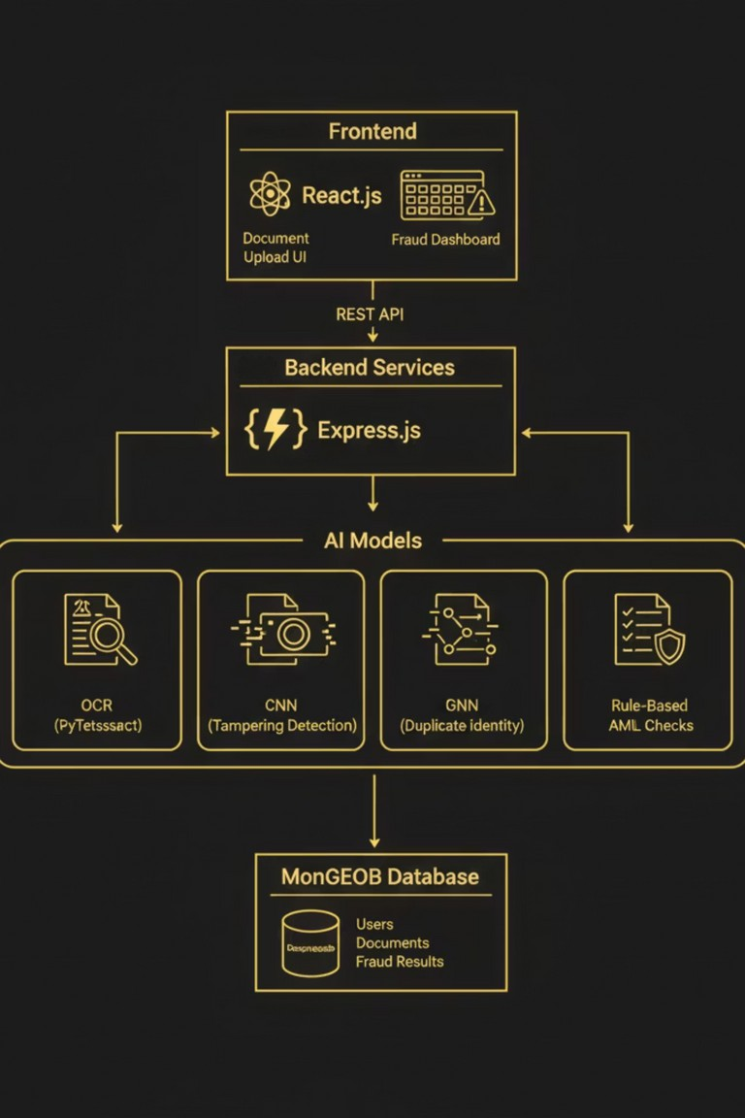
System Architecture
Frontend: React.js UI for document upload & fraud dashboard
Backend: Express APIs for model serving and fraud pipeline
AI Models:
OCR (Pytesseract) for text extraction CNN for tampering detection
GNN for duplicate identity detection Rule-based AML checks
Database: MongoDB for Users, Documents, Fraud Results

Slide 5
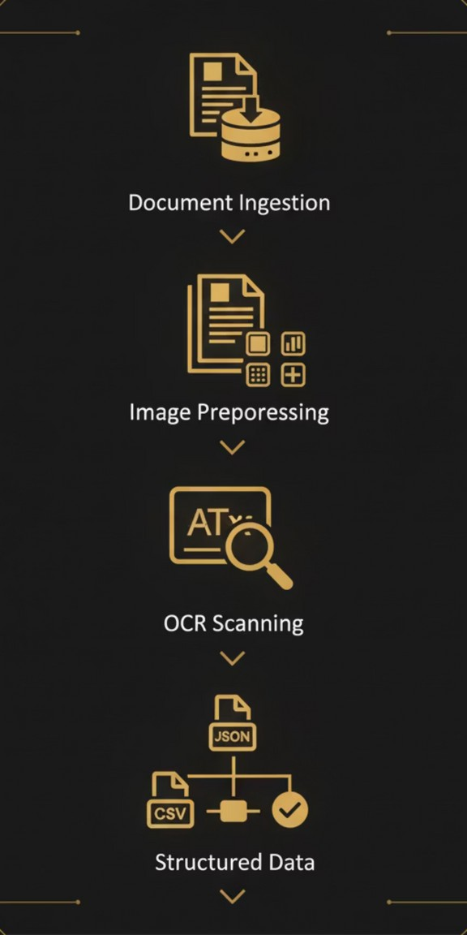
Milestone 1 – Data Collection & Preprocessing
Objective:
Build a reliable pipeline for document ingestion and structured data extraction.
Key Contributions:
Labeled 20+ synthetic Aadhaar and utility bill samples.
Applied Pytesseract OCR with preprocessing for accuracy.
Structured output into JSON/CSV formats.
Developed simulation.
Outcome:
a basic upload interface for input
95% text extraction accuracy with a robust, scalable OCR pipeline.

Slide 6
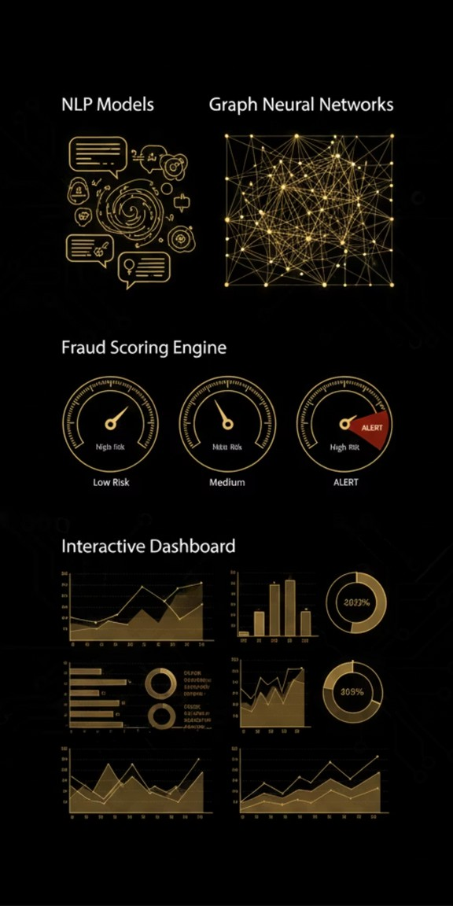
Milestone 2 – AI Model Development & Fraud Detection
Objective:
Leverage AI to detect fraudulent patterns in KYC documents.
Key Contributions:
NLP Models: Trained with Azure OpenAI + rule-based logic for entity matching.
Graph Neural Networks: Built to detect identity links and duplication patterns.
Fraud Scoring Engine: Classified risk levels into Low, Medium, and High.
Interactive Dashboard: Implemented for real-time fraud analytics and insights.
Result:
Achieved >90% fraud detection accuracy for scalable risk assessment.

Slide 7
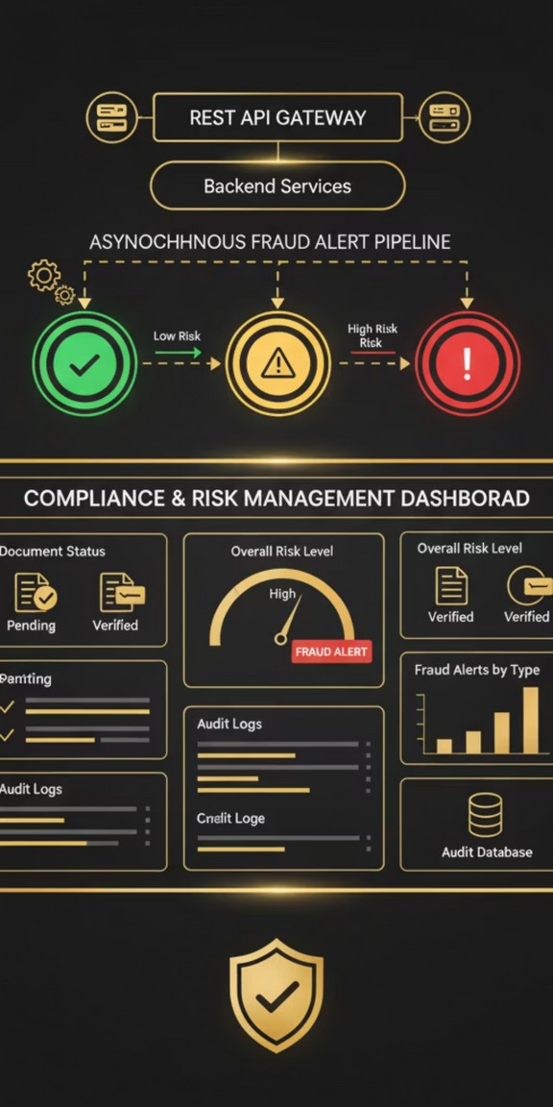
Milestone 3 – AML/KYC Compliance Integration
Objective:
Embed AI verification into live AML/KYC compliance workflows.
Key Contributions:
Developed REST APIs for real-time identity validation. Built async pipelines to trigger fraud alerts by risk level. Implemented audit logging for regulatory traceability.
Designed a compliance dashboard with document status and alerts.
Result:
Integrated fraud detection into AML systems, enhancing compliance visibility and efficiency.

Slide 8
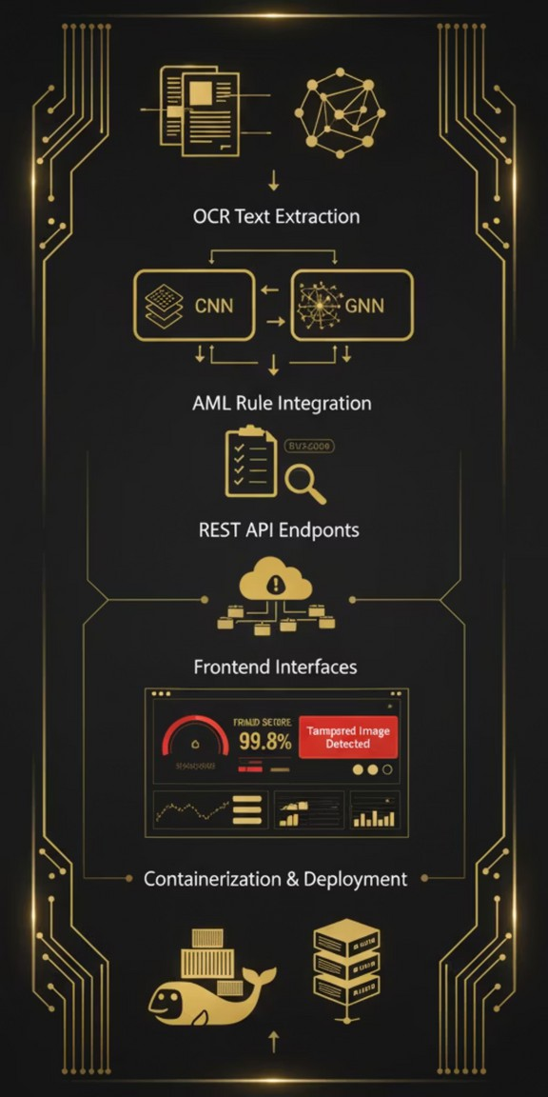
Milestone 4 – System Integration & Deployment
Objective:
Deploy a production-ready full-stack AI fraud detection system with real-time analytics.
Key Contributions:
Built final pipeline combining OCR, AI models (CNN/GNN), and AML rules.
Developed REST APIs for document upload and fraud analysis.
Integrated frontend to show fraud scores, labels, and reasons (e.g., “Tampered image”).
Deployed system via Docker and validated with multiple fraud scenarios.
Result:
Delivered a real-time, explainable fraud detection system with dashboards and compliance support.

Slide 9
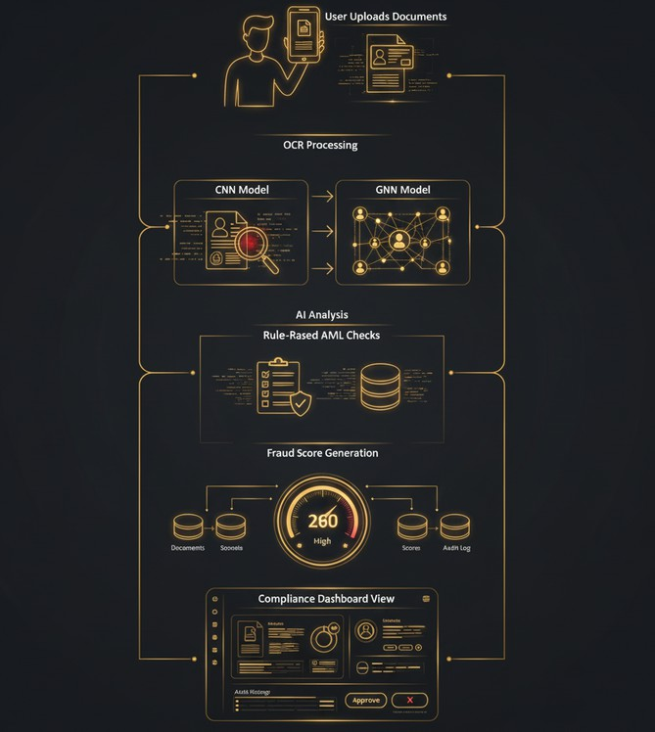
Workflow

Slide 10
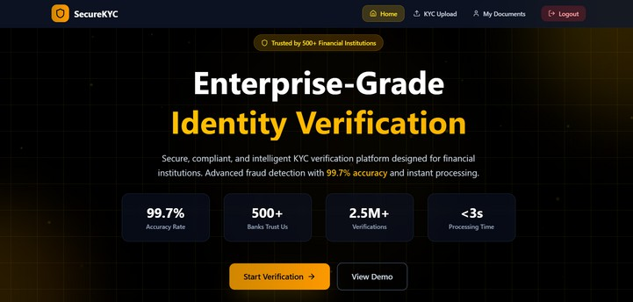
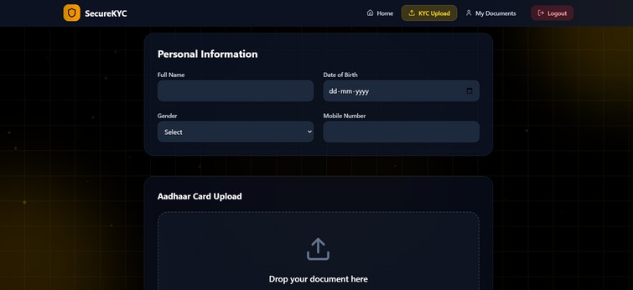
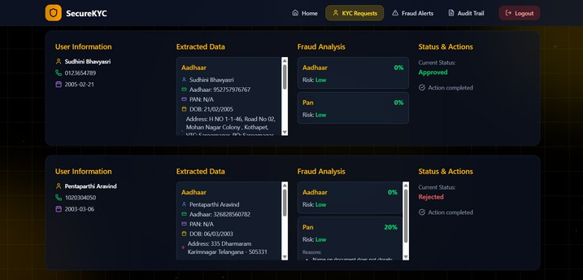
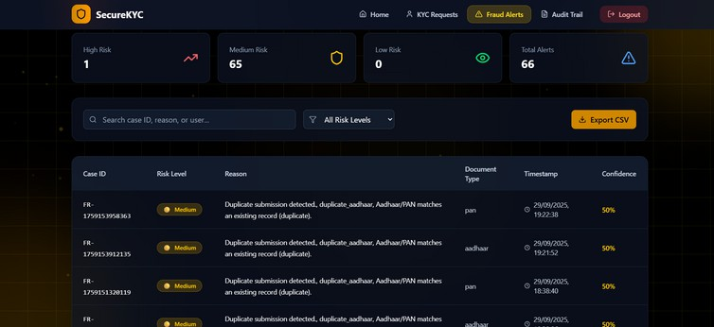
Frontend

Slide 11
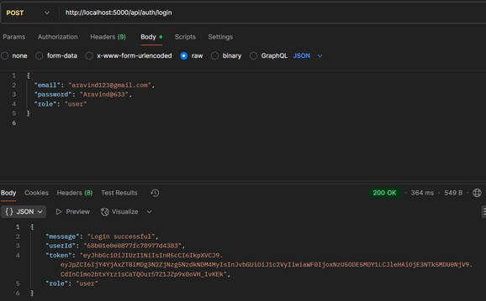
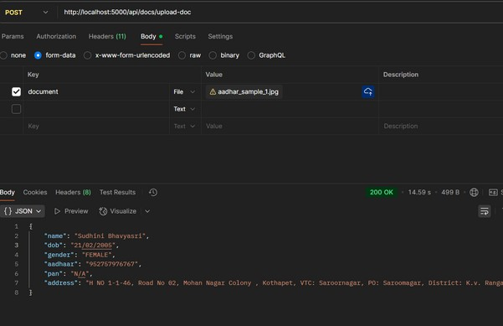
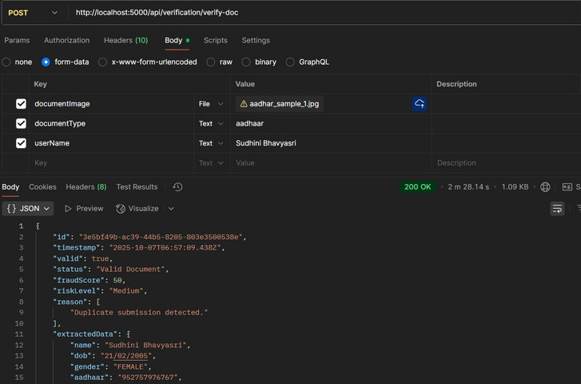
Backend

Slide 12
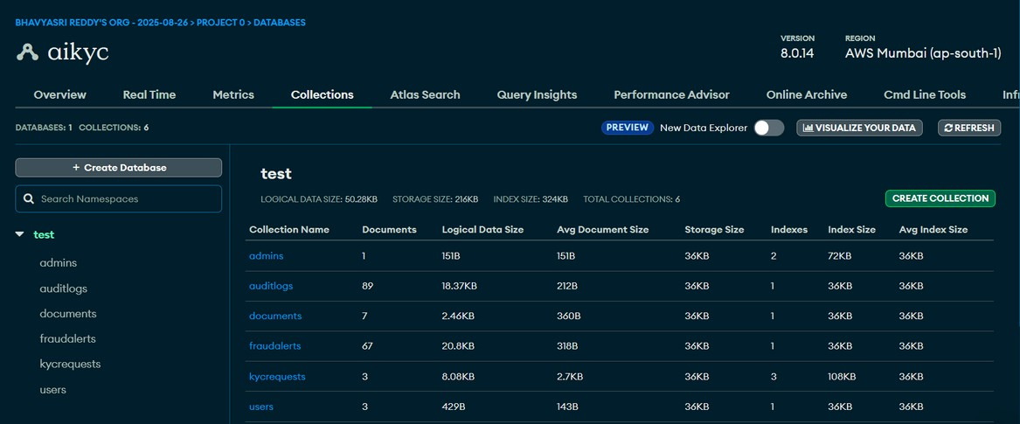
Database

Slide 13
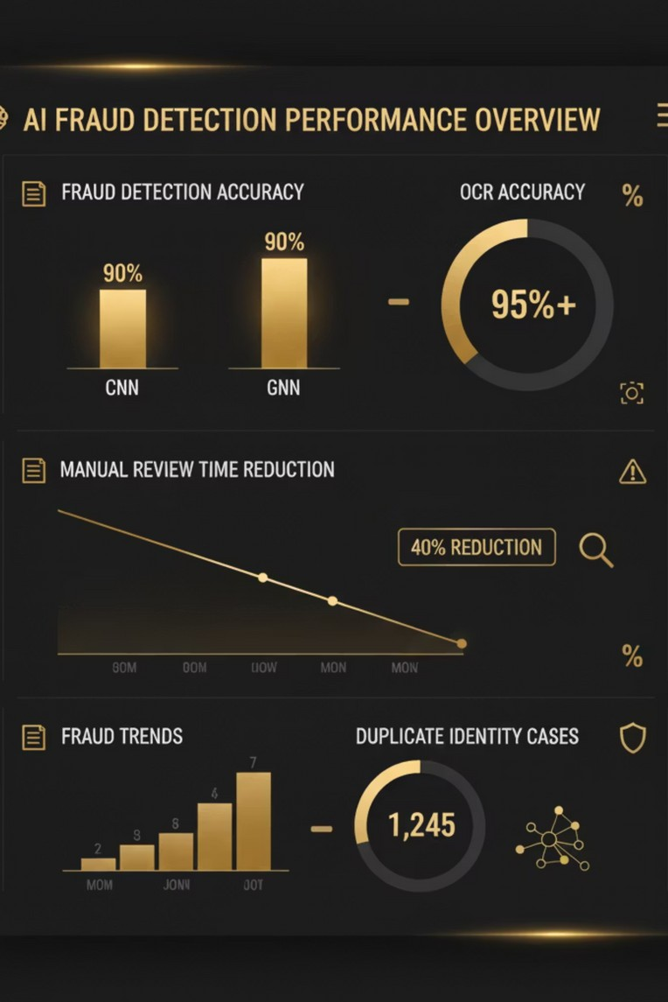
Results & Evaluation
Performance Metrics:
OCR Accuracy: 95%+ — Precise extraction from images and PDFs Fraud Detection Accuracy: 90%+ — Reliable identification of tampered documents
Manual Verification Time: Reduced by 40% — Faster onboarding and processing

Slide 14
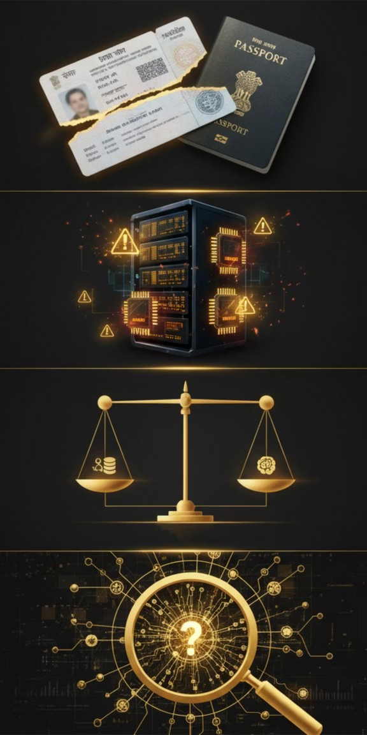
Challenges Faced
Handling incomplete or low-quality document images.
Resource constraints while deploying AI models.
Balancing development between frontend, backend, and ML.
Ensuring explainability of AI results for compliance officers.

Slide 15
Future Enhancements
Official Identity API IntegrationConnect with Aadhaar and PAN verification APIs for real- time identity validation.
Global AML Database IntegrationIncorporate international blacklists and watchlists for enhanced risk screening.
Multi-language OCR SupportEnable text extraction in regional languages like Hindi, Tamil, etc., for broader document coverage.
Tamper-Proof KYC Storage
Leverage blockchain to store KYC data with immutable, auditable records.

Slide 16
Conclusion
Delivered an end-to-end AI-driven KYC verification system.
Real-time fraud detection and compliance alerting. Enables banks and fintechs to onboard users securely.
Scalable foundation for next-gen regulatory tech (RegTech).

Slide 17


